Slide 1
Correlational Analysis of COVID-19
Presents by Yujia Zhang
Key Words: COVID-19, Mortality, Age, Gender, Ethnicity, Blood type, Smoking
USC Mark and Mary Stevens Neuroimaging and Informatics Institute
USC Laboratory of Neuroimaging
loni.usc.edu

Slide 2
Research Goals
COVID-ARC:
COVID-ARC, COVID-19 Data Archive, is a data archive developed to help address the need for a better understanding of COVID-19. We collected data related to the COVID-19 including, but not limited to CT and X-Ray images.
Why is COVID-19 mild for some, but deadly for others?
Goals:
Find the correlation of COVID-19 and other factors such as gender, blood types, and so on.
USC Mark and Mary Stevens Neuroimaging and Informatics Institute
USC Laboratory of Neuroimaging
loni.usc.edu

Slide 3
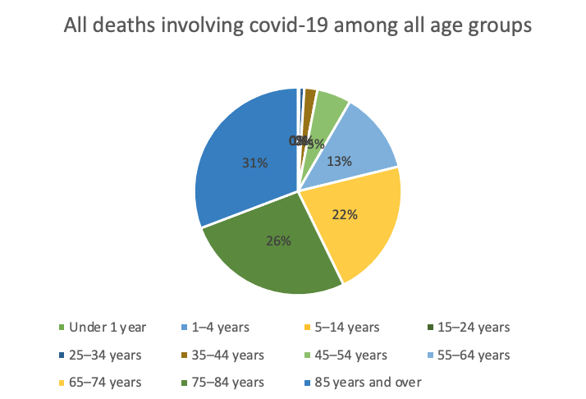
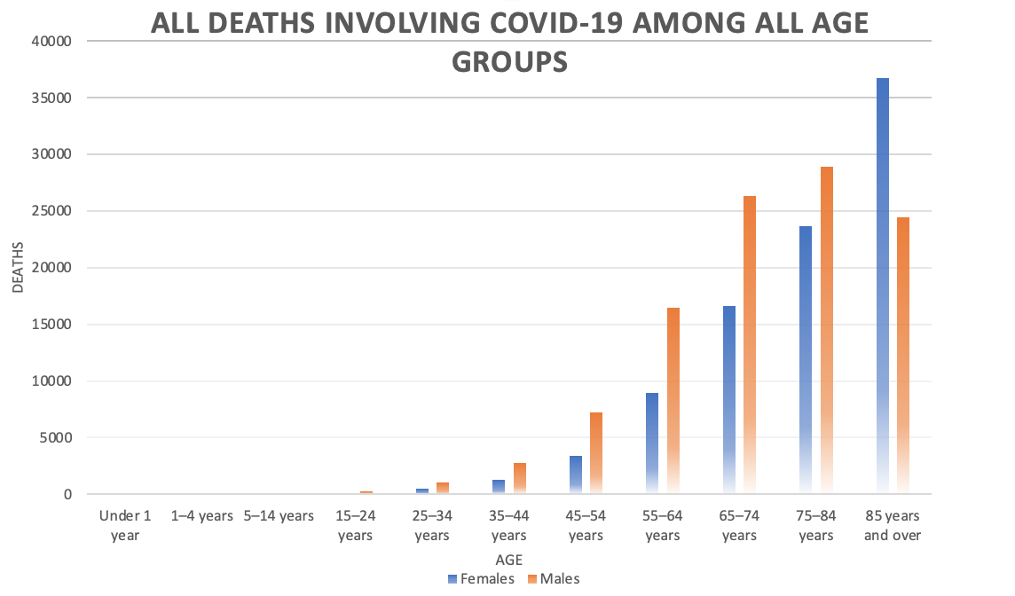
AGE
https://covid.cdc.gov/covid-data-tracker/?CDC_AA_refVal=https%3A%2F%2Fwww.cdc.gov%2Fcoronavirus%2F2019-ncov%2Fcases-updates%2Fcases-in-us.html#cases_casesper100klast7days
USC Mark and Mary Stevens Neuroimaging and Informatics Institute
USC Laboratory of Neuroimaging
loni.usc.edu

Slide 4
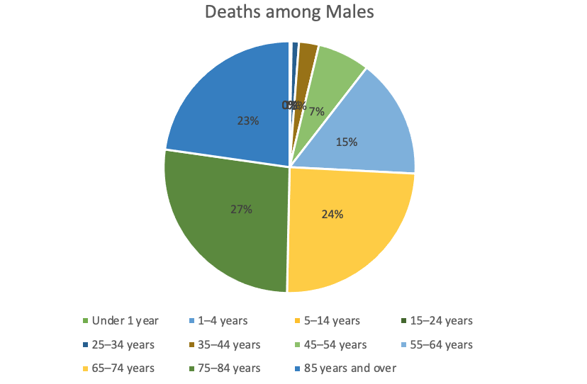
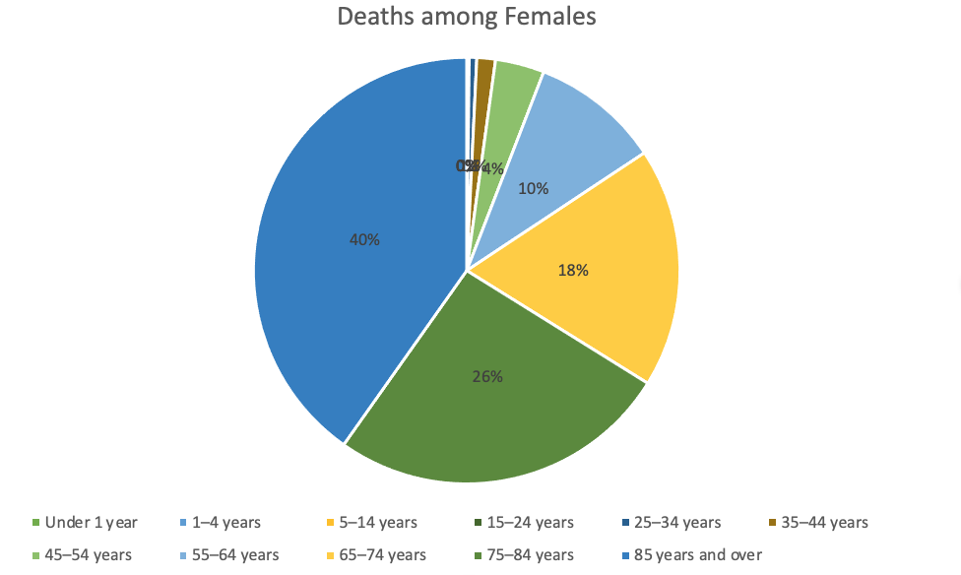
Gender
https://covid.cdc.gov/covid-data-tracker/?CDC_AA_refVal=https%3A%2F%2Fwww.cdc.gov%2Fcoronavirus%2F2019-ncov%2Fcases-updates%2Fcases-in-us.html#cases_casesper100klast7days
USC Mark and Mary Stevens Neuroimaging and Informatics Institute
USC Laboratory of Neuroimaging
loni.usc.edu

Slide 5
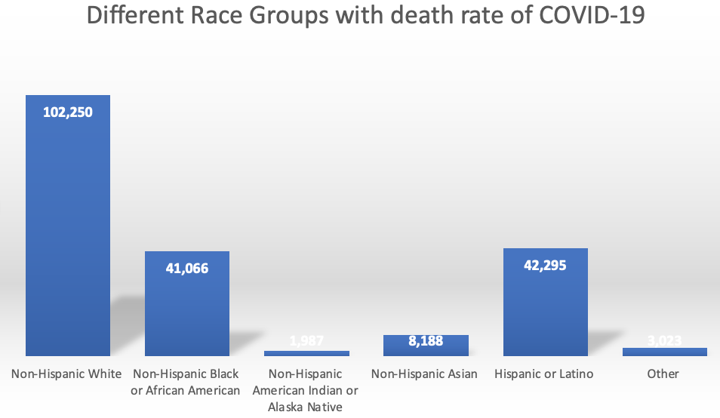
Ethnicity
https://covid.cdc.gov/covid-data-tracker/?CDC_AA_refVal=https%3A%2F%2Fwww.cdc.gov%2Fcoronavirus%2F2019-ncov%2Fcases-updates%2Fcases-in-us.html#cases_casesper100klast7days
USC Mark and Mary Stevens Neuroimaging and Informatics Institute
USC Laboratory of Neuroimaging
loni.usc.edu

Slide 6
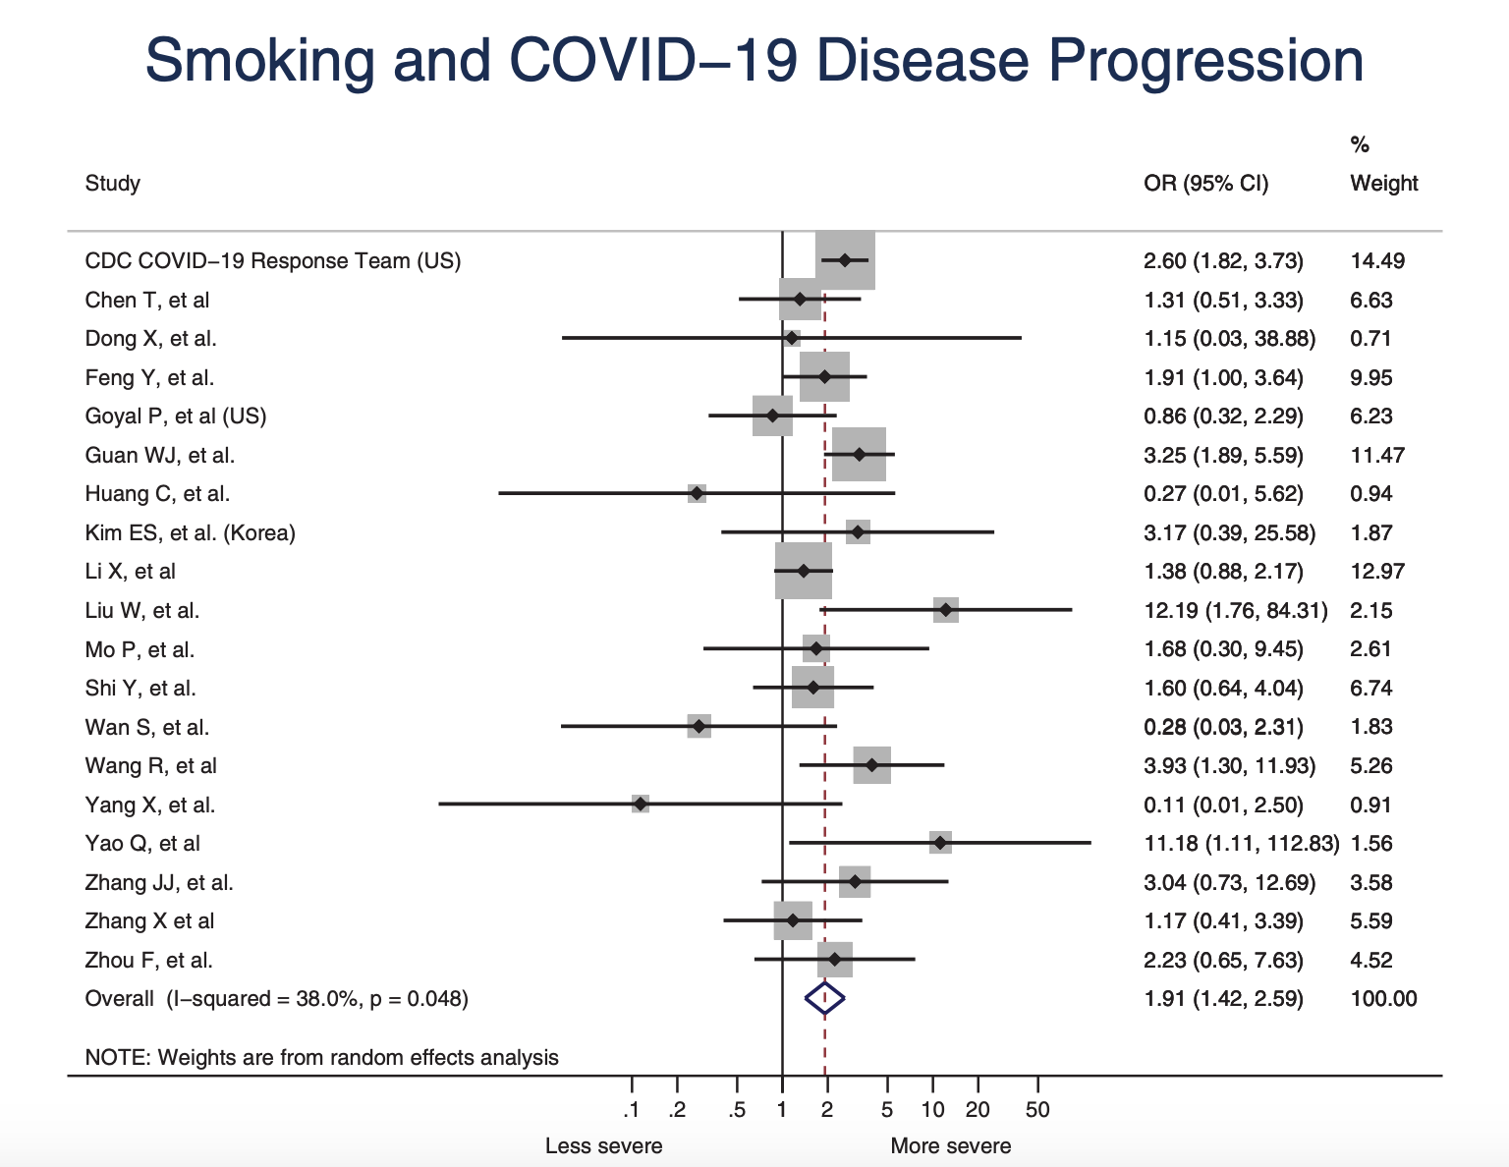
Smoking
SMOKING STATUS | ODD RATIO AJUSTED FOR AGE, SEC AND ETHNIC SECTION | ODD RATIO AJUSTED COMORBIDITIES
Never Smoker | Reference | Reference
Current Smoker | 0.618 | 0.586
Past Smoker | 1.347 | 1.108
1. Patanavanich, R., & Glantz, S. A. (2020). Smoking Is Associated With COVID-19 Progression: A Meta-analysis. Nicotine & Tobacco Research, 22(9), 1653–1656. https://doi.org/10.1093/ntr/ntaa082
2. Israel, A., Feldhamer, I., Lahad, A., Levin-Zamir, D., & Lavie, G. (2020). Smoking and the risk of COVID-19 in a large observational population study, 1–13. https://doi.org/10.1101/2020.06.01.20118877
USC Mark and Mary Stevens Neuroimaging and Informatics Institute
USC Laboratory of Neuroimaging
loni.usc.edu

Slide 7
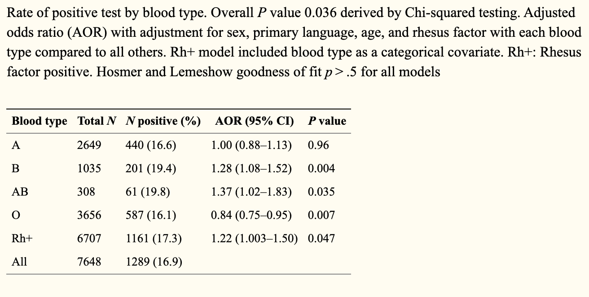
Blood Types
People with type O blood seemed to be less likely to become infected.
A higher proportion of Covid-19 patients with blood group A or AB required mechanical ventilation and had a longer ICU stay compared with patients with blood group O or B.
Latz CA, DeCarlo C, Boitano L, et al. Blood type and outcomes in patients with COVID-19. Ann Hematol. 2020;99(9):2113-2118. doi:10.1007/s00277-020-04169-1
Hoiland, R. L., Fergusson, N. A., Mitra, A. R., Griesdale, D. E. G., Devine, D. V., Stukas, S., … Sekhon, M. S. (2020). The association of ABO blood group with indices of disease severity and multiorgan dysfunction in COVID-19. Blood Advances, 4(20), 4981–4989. https://doi.org/10.1182/bloodadvances.2020002623
USC Mark and Mary Stevens Neuroimaging and Informatics Institute
USC Laboratory of Neuroimaging
loni.usc.edu

